Slide 1
Woodland Public Schools
Facilities and Safety
February 2017 report

Slide 2
FACILITIES REPORT
CO Detectors
Carbon Monoxide (CO) detectors have been installed in all of the classrooms at the WMS campus. Additional detectors have been ordered for the 1st grade wing of the Primary School. These two schools have indirect fired gas heating systems. Natural gas fired equipment creates CO as part of the burning process. Normally this gas is exhausted and poses no danger to occupants of spaces heated with natural gas. There is always a possibility that the equipment can malfunction and contaminate the clean air stream with CO. If the level reaches the alarm set point (expressed PPM) an alarm will activate to alert staff to evacuate the space. Instructions have been given to the school on how to proceed in the event of an alarm.
Security Camera System WPS
Due to the increased level of tagging activity we are moving forward with the installation of a security camera system at WPS. Due to the high cost of contracting this out, we have pulled this project in house. A 16 camera system has been purchased and will be installed as time permits. I would expect to have the system installed to some level by the end of the spring break.
Portable install Woodland Intermediate School – Permits were filed with the city of Woodland the week of March 6th. Grading of the site will occur during spring break and foundation gravel will be installed. Additionally WIS HVAC equipment will be moved to accommodate the clearance necessary for the building access ramps. The goal is to have the site ready and install the buildings first week of summer.

Slide 3
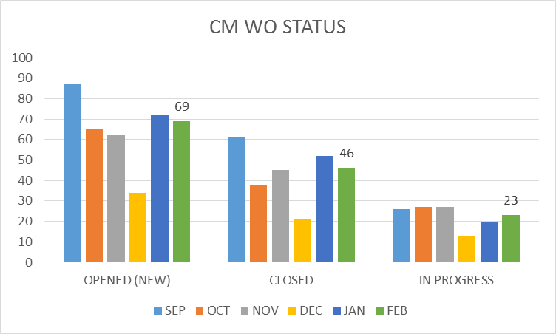
FACILITY CHARTS – POWER COST AND WORK ORDER STATUS
Increased Power consumption all campus in January
attributed to lower than normal temperatures in
Woodland.

Slide 4
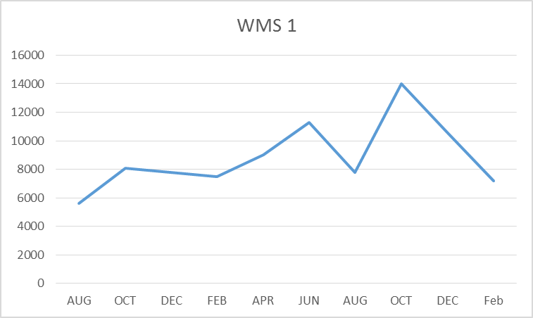
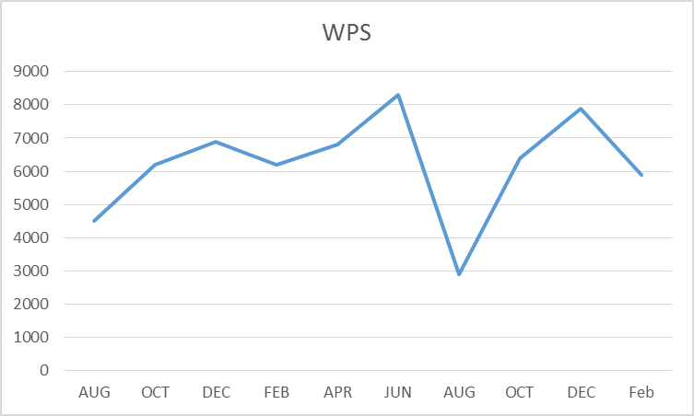
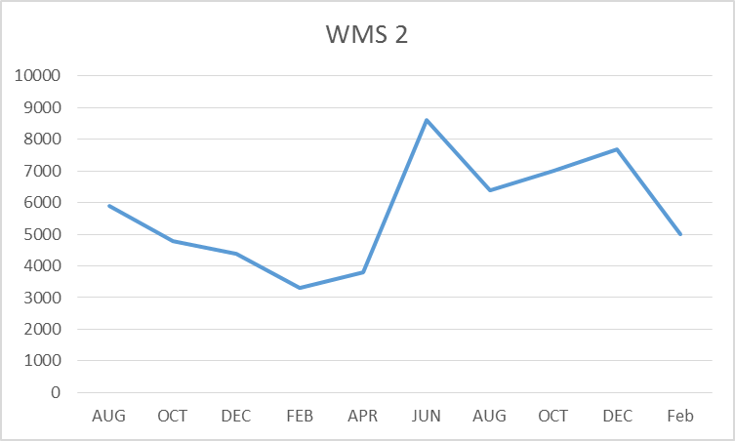
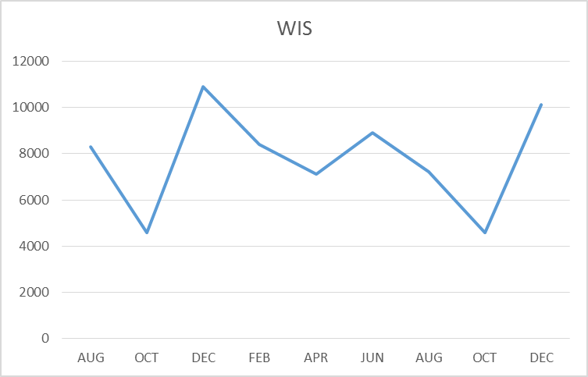
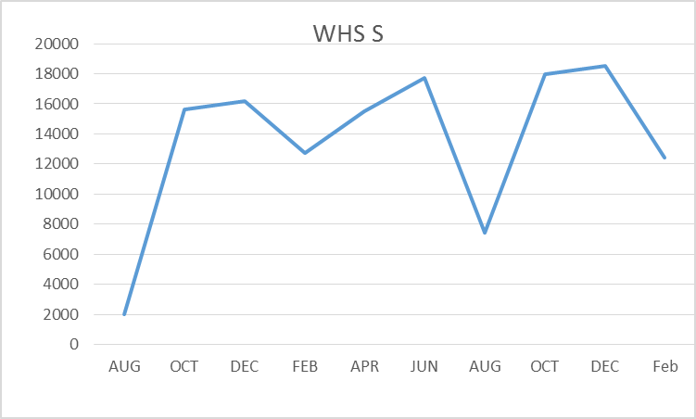
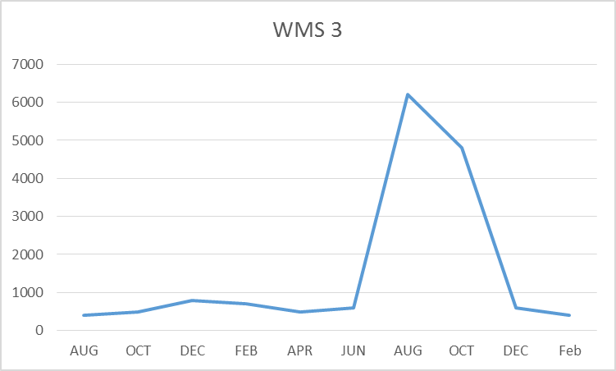
FACILITY CHARTS – WATER USAGE- WHS, WIS, WMS, WPS
Irrigation at WHS is flowing 1400 CF/mth.
(10,472 gallons) with system isolated.
Currently troubleshooting this problem
Water billed every two months.
Next update will be in May report
for March and April

Slide 5
SAFETY
Accidents for the month
There were a total of 12 injuries in the month of February-4 Staff and 8 students
Staff Accidents/Incidents (4)
WPS – Employee cut finger on edge of can
WPS – Employee injured hip trying to diffuse situation with angry student
WIS – Employee slipped on concrete, said his shoes were a poor choice, purchased new shoes
WMS – Custodian cut finger on broken glass left in classroom, glass gloves ordered, staff notified
Student Accidents/injuries (8)
WIS – Student ran into pole. Placed reflective tape on pole, head injury
WHS – Student passed out after being choked, hit head, concussion. Student disciplined by staff
WHS – Student stabbed leg with scissors when backpack slid down arm, 22 stiches
WHS – Student fell backward playing catch, hit head, monitored and notified parent.
WPS – Student hit mouth on table after loosing balance, saw Dentist
WPS - Student hit leg on table support when getting up, contusion - ice applied
WPS - Student hit by swing in head, 3 staples. Swing is incomplete and will be removed.
WPS – Student tripped, hit head on table. Contusion, ice applied

Slide 6
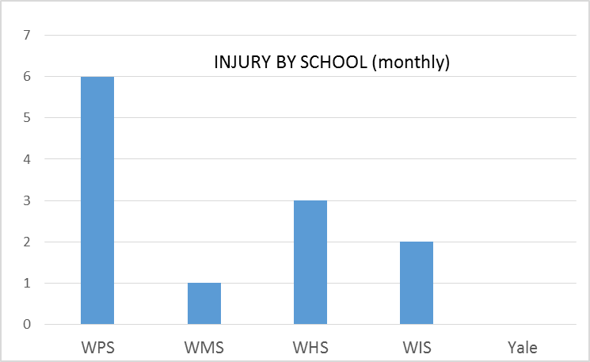
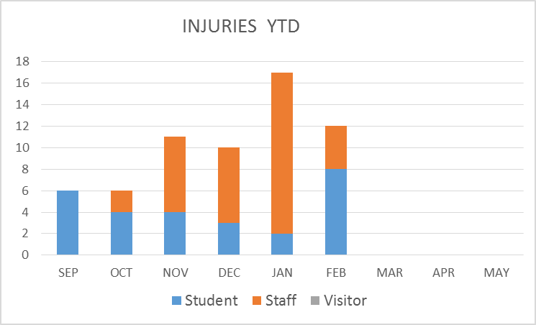
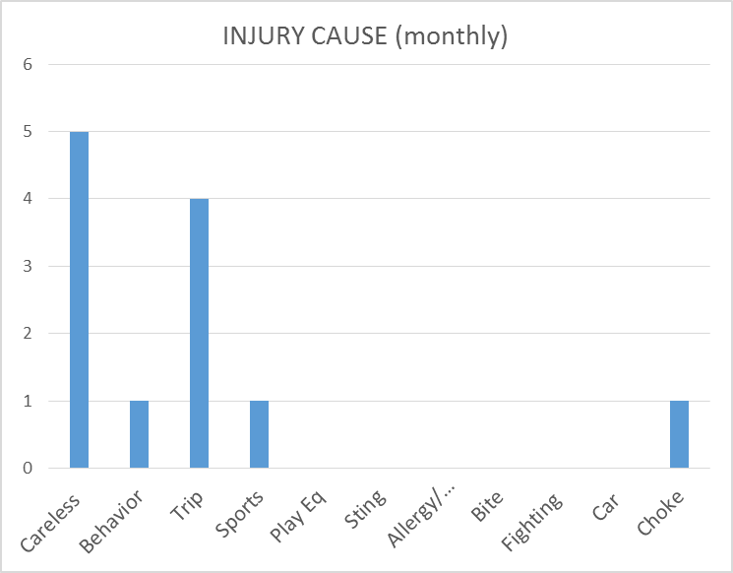
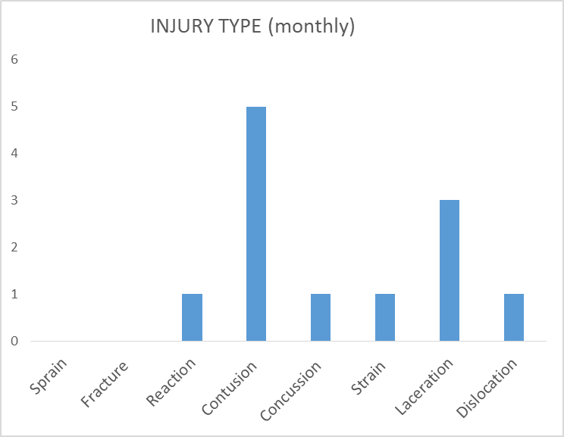
SAFETY CHARTS

